Slide 1

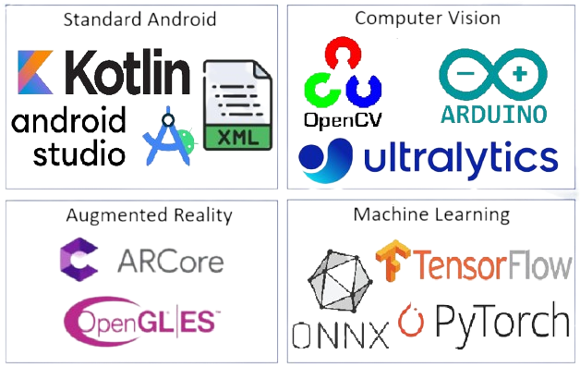




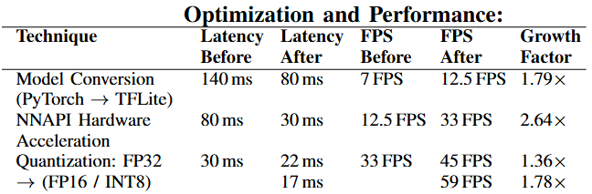
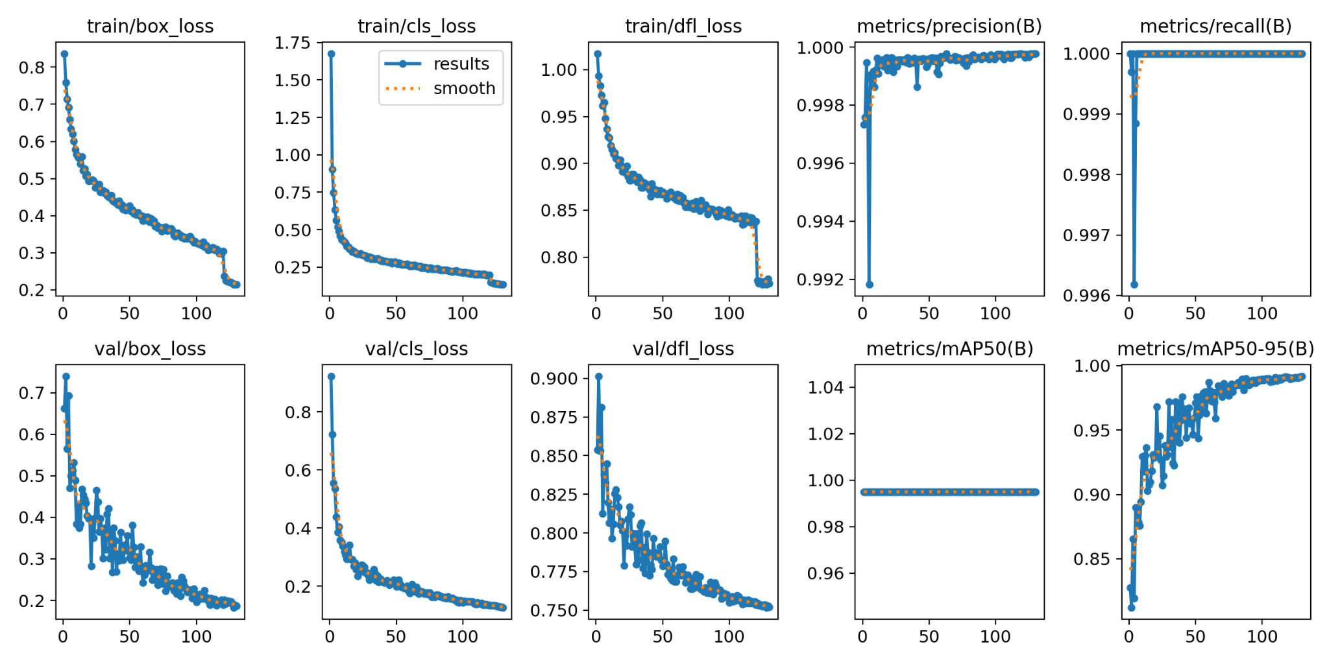
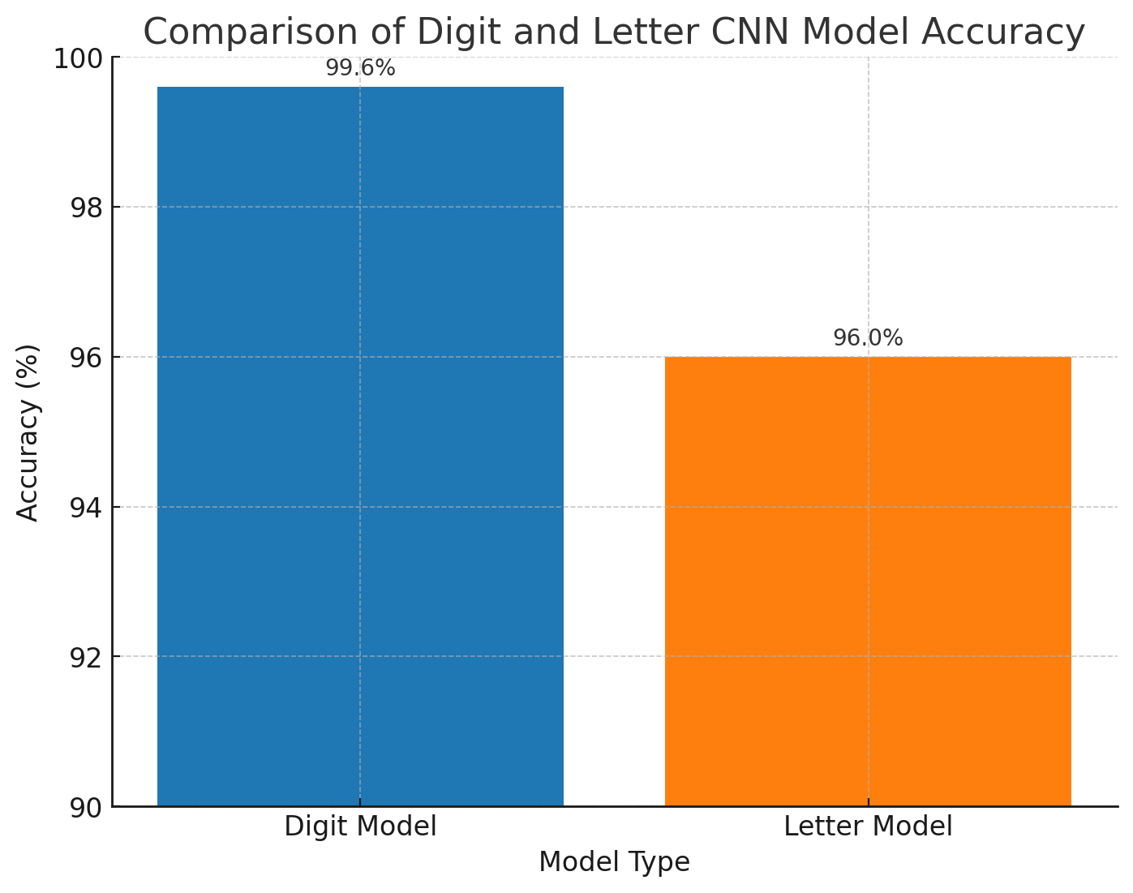
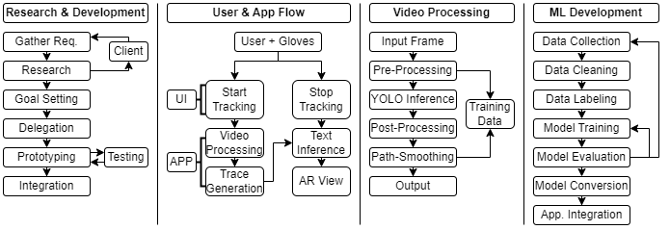
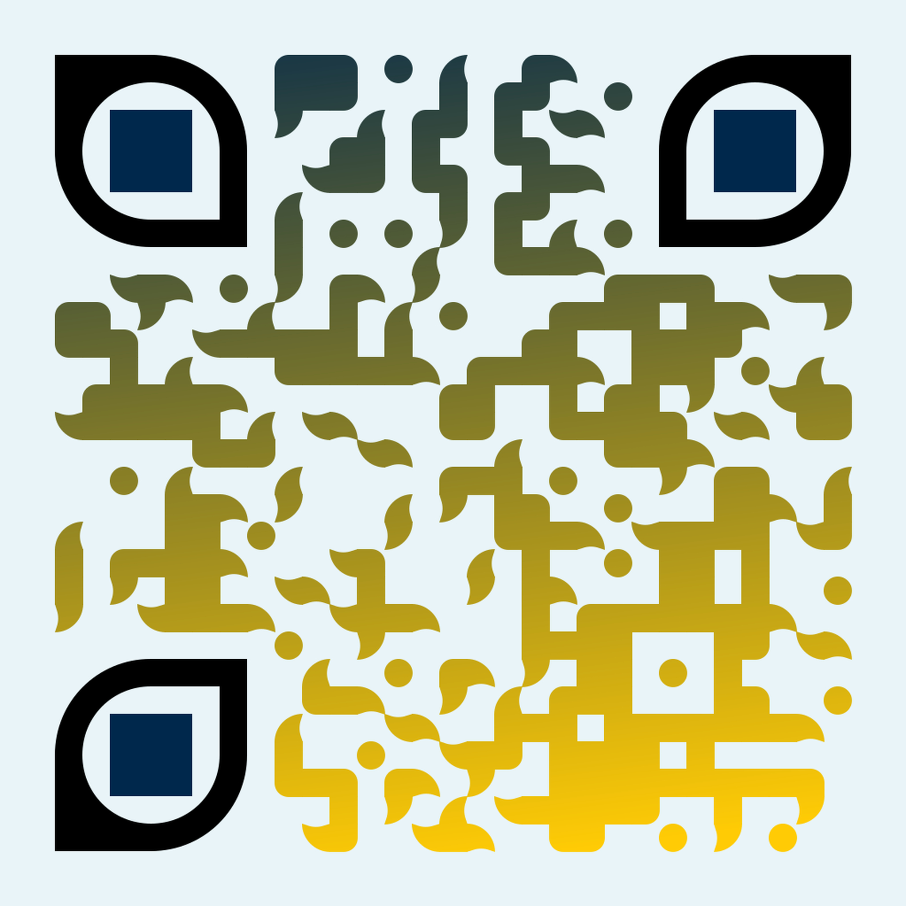
Xamera | Adaptive HCI
Team: Deniz Acikbas, Soham Naik, Zaynab Mourtada, Alan Raj
Senior Design Course Faculty: Mahmoud Abu-Nasr, Khalid Kattan, Bruce Maxim, Thomas Steiner
Client: Xiao Zhang
Problem Statement
Existing real-time 3D gesture recognition systems are typically relegated to lab environments, reducing practical accessibility for everyday mobile devices.
Project Planning
Meetings
Regular team and client meetings to share research, gather requirements, validate direction, and set clear goals.
Modular Approach
Divided the project into four modules: mobile app, video processing & YOLO, trace generation & smoothing, and ARCore visualization, with team leads for each.
Iterative Refinement
Continuously broke down modules into smaller goals through feedback and collaboration, ensuring individual expertise and cohesive system integration.
Technologies Used
Project Objective
Our objective was to build a mobile, real-time proof of concept that validates the technical viability of Dr. Zhang’s RoFin pipeline on consumer-grade hardware.
We designed a smartphone-based system capable of tracking LED-equipped fingertips using YOLO, smoothing motion paths with multi-stage filters, and classifying paths using a CNN model.
Rather than focusing on user studies or accessibility from the outset, this project aimed to answer a core technical question:
Can advanced 3D gesture tracking work reliably on a mobile device, outside the lab?
Results & Performance Evaluation
Our system delivers real-time responsiveness with over 33+ FPS, demonstrating its practical use for gesture-based input.
Evaluations performed on Google Pixel 8A under natural lighting conditions typical of indoor environments.
Real-World Applications
Our system opens up new possibilities for interacting with technology, especially when traditional input methods fall short.
Assistive Input for Motor Impairments
People with Parkinson’s disease, essential tremor, or limited fine motor control can use air gestures as touch-free alternative, making tech more accessible and frustration-free.
Touchless Text Input
Writing in the air with LED-guided gestures is perfect for sterile environments, AR/VR applications, or situations where touch isn’t practical.
Collaborative XR Interfaces
Supports multi-user, multi-hand interaction in AR spaces, enabling collaborative design, education, and remote communication.
Next-Gen Mobile HCI
Shows how consumer devices can handle 3D spatial input, paving the way for gesture-driven mobile apps.
Our project combines these innovations to create a more intuitive, hands-free user experience.
Supporting Research
Our project builds on some innovative research in hand gesture recognition, air-writing, and real-time mobile vision.
One key influence in RoFin: 3D Hand Pose via Rolling Fingertips (Zhang et al., ACM MobiSys 2023). This system uses 2D fingertip trajectories captured by rolling shutter cameras to reconstruct 3D hand poses in real time. We adapted this approach to accurately track fingertip motion and create 3D gesture paths on mobile devices.
Another important reference is Air-Text: Air-Writing Recognition System (Lee & Kim, ACM Multimedia 2021), which enables users to write in the air by converting fingertip movements into text. This inspired our gesture-to-text pipeline, enhancing writing input for better usability.
By integrating insights from these studies, we developed a more precise and user-friendly gesture recognition system for mobile platforms.
We achieved impressive accuracy:
➙ 99.86% YOLO accuracy
➙ 99.6% CNN accuracy for digits
➙ 96% CNN accuracy for letters
YOLOv11Nano Training Metrics
Model accuracy (precision, recall, and mAP) and loss reduction over epochs. High convergence and minimal validation loss indicate a robust, well-trained model ready for real-time tracking.
Technical Requirements Constraints
Mobile Platform
Develop a deployable mobile application.
Object Tracking
Use LED-tipped gloves for detecting hand gestures.
Unique IDs
Implement OOK-encoded LED patterns to support multiple users.
Detection
Utilize YOLO for object and pattern recognition.
Trace Processing
Reduce noise in the gesture trace.
AR Display
Visualize the processed trace in augmented reality.
Design Trade-Offs
In developing Xamera, we made intentional decisions to balance performance, accuracy, and real-time usability on mobile hardware. Below are key trade-offs and our rationale:
Trade-Off | Our Decision | Why it Matters
Accuracy vs Speed | YOLOv11Nano over heavier models. | Real-time performance >30FPS
Speed vs Abstraction | TensorFlow Lite over PyTorch. | Faster inference on mobile, full HW util.
Simplicity vs Stability | Added multi-stage smoothing. | Reduced noise in gesture paths.
Inference Model Accuracy Comparison
The following graph shows the accuracy of our two custom CNN models: Digit Model (99.6%) and Letter Model (96%). The digit model performs slightly better due to the more consistent patterns in digits compared to letters.
Limitations & Future Work
Requires LED gloves, future work could explore markerless finger tracking.
Accuracy varies in outdoor lighting and with multiple users - additional tests needed for robustness.
Explore our GitHub repo!
Computer and Information Science Department
Senior Design Day 2025
Notes:
https://youtube.com/shorts/-hY8GaYtvag?feature=share

